Slide 1
African Centre for Meteorological Applications for Development (ACMAD)
Organization of RCOFs, formulation of consensus forecasts and dissemination of forecasts by ACMAD
Prepared by
Hubert Kabenguela and Dr. Bob Alex Ogwang
Meeting organized by UNECA/ACPC, May 14, 2018 - DJIBOUTI
1

Slide 2
Presentation Outline
Organisation of RCOFs
Consensus forecast process
Dissemination and feedback
2

Slide 3
1. Organisation of RCOFs
ACMAD currently organises 5 RCOFs over the continent
PRESASS (Sudano-Sahelian region) - April/May
MEDCOF/PRESANOR (Northern Africa) - November and March
PRESAGG (Gulf of Guinea) - February/March
PRESAC (Central Africa) - August/September
SWIOCOF (Southwestern Indian Ocean) - September/October
During RCOFs, two products-presented
Regional Long Range Forecast Bulletin (providing advisories to experts in different sectors (e.g. Agriculture, Water resources, DRR, etc.)
Brief for policy and decision makers (e.g. Development planners and Managers, etc.)
3

Slide 4
2. Consensus Forecast Process
Input to the consensus forecast
Dynamical models- Single and multimodel ensembles
Statistical models - based on CPT
Analysis of Analogue years - based on SST patterns analysis
Analysis of cumulative precipitation estimates
Persistence analysis
Composite analysis
Climate variability (drivers) and trends analysis

Slide 5
Consensus Forecast Output
Three products - generated
a. Technical Note (Meant for climate experts)
-Summary of drivers necessary to generate forecast
b. Long Range Forecast bulletin (Targets experts in other sectors e.g. Water resources, Agric, Health, Energy, DRR, etc)
c. Brief for policy and decision makers -Based on expected significant weather and climate events (Targets Policy and Decision makers).

Slide 6
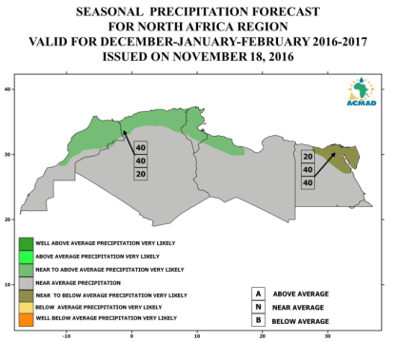
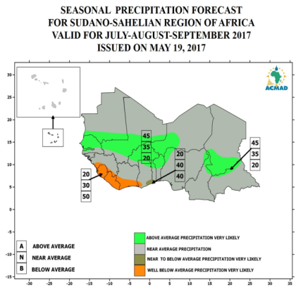
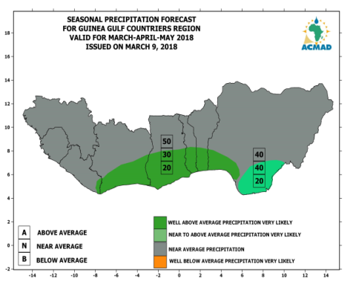
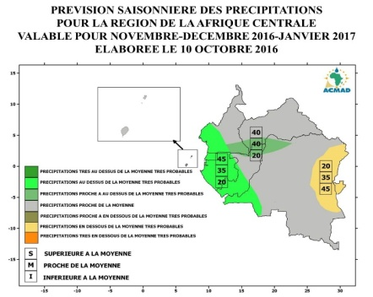
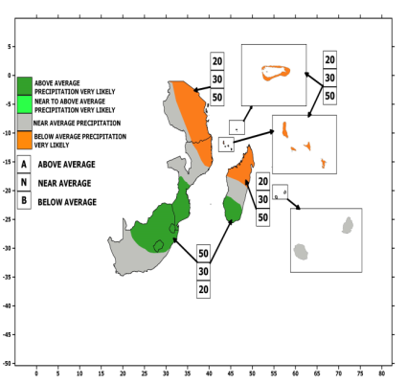
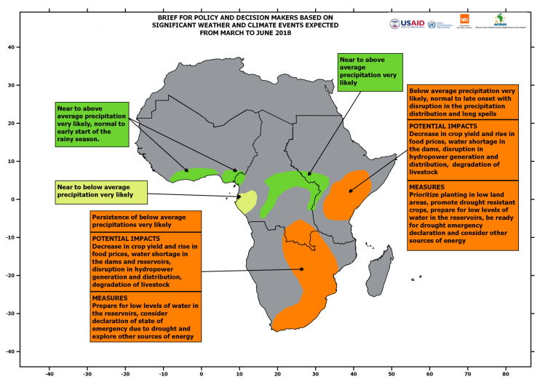
Sample Consensus Forecasts over the 5 regions

Slide 7
3. Dissemination and feedback
Dissemination
Press Release
Emails
Website
Presentation at various stakeholder meetings
Feedback
During forums (National, Regional and Continental)
Emails

Slide 8
Thank you for your attention.
8

