Slide 1
Post RTP Data Access
The S2S Project real-time pilot will end on October 31 2022 and real-time access to the S2S database will cease then
We’ve been exploring the possibility of you paying for access to ECWMF Data

Slide 2
ECMWF Data
ECMWF Data Charging Model Consists of three elements
  Information cost (depends on the number of fields/resolution/domain size/number of timesteps)
  Volume charge (banded)
  Service charge (depends on volume and level of service)
You can explore the cost of the data at
https://apps.ecmwf.int/shopping-cart/
You need to create and account to get a costing
We will walk you through an example

Slide 3
Volume and service charge
Volume Band | Volume Band (GB) | Volume + Basic (€) | Volume + Bronze (€) | Volume + Silver (€) | Volume + Gold (€)
1 | Up to 365 | 700 | 730 | Not available | Not available
2 | Up to 3,650 | 2,300 | 2,570 | Not available | Not available
3 | Up to 18,250 | 9,500 | 10,850 | 11,570 | Not available
4 | Up to 36,500 | 15,500 | 17,750 | 18,950 | 20,000
5 | Up to 182,500 | 66,500 | 76,400 | 81,680 | 86,300
6 | Up to 365,000 | 110,500 | 127,000 | 135,800 | 143,500
7 | Up to 547,500 | 130,500 | 150,000 | 160,400 | 169,500
Unit Price (P)
A unit price of P = 0.50 EUR per EPU is applied to all Products in the Catalogue.
Volume discount
The following discount scheme, based on the unit price P = 0.50 EUR, applies.
Number of chargeable
EPUs per year [N] Discount Price [EUR]
0 - 2,000 N x P
2,001 - 20,000 [2,000 + 0.6 (N - 2,000)] x P
20,001 - 200,000 [12,800 + 0.4 (N - 20,000)] x P
200,001 and more [84,800 + 0.2 (N - 200,000)] x P
https://confluence.ecmwf.int/display/DAC/ECMWF+service+charge+model+for+real-time+data%3A+July+2022+onwards

Slide 4
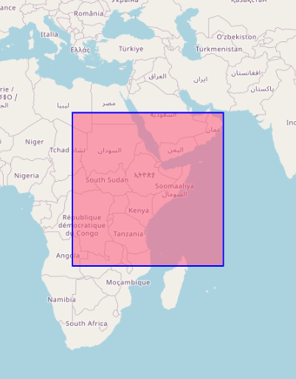
Information Charge Example
24 hourly accumulated precipitation
6 hourly 2m Tmin, Tmax
24 hourly T,q,u,v @925hPa
Out to day 46
Area 25N-15S, 20E-60E
0.4deg Resolution
Every Monday
Estimated Annual Volume 125GB
EPUs = 6036
Information cost €2,210 pa
Volume + Service €730 pa
Total €2,940 pa

Slide 5
Information Charge Example
24 hourly accumulated precipitation
6 hourly 2m Tmin, Tmax
24 hourly T,q,u,v @925hPa
Out to day 46
Area 25N-15S, 20E-60E
0.4deg Resolution
Every Monday
Estimated Annual Volume 125GB
Information cost €2,210 pa
EPUs 6036
Volume + Service €730 pa
Total €2,940 pa
Change to 1.5deg resolution
Information cost €743
(note domain also decreases slightly)
Reduce domain to Kenya
(6.4N-6.8S,32-43.2E)
  Information cost €281

Slide 6
Delivery
ECMWF Data is “pushed” to either
  An ftp/sftp site
  Cloud based service (Amazon S3 bucket, Microsoft Azure Blob, Google Cloud)
  https://confluence.ecmwf.int/display/DAC/Set-up+for+delivery+of+real-time+forecast+data+from+ECMWF

