Slide 1

MHEWS FORDRR IN AFRICA
Andre Kamga – ACMAD

Slide 3
5 days forecasts for extreme storms

Slide 4
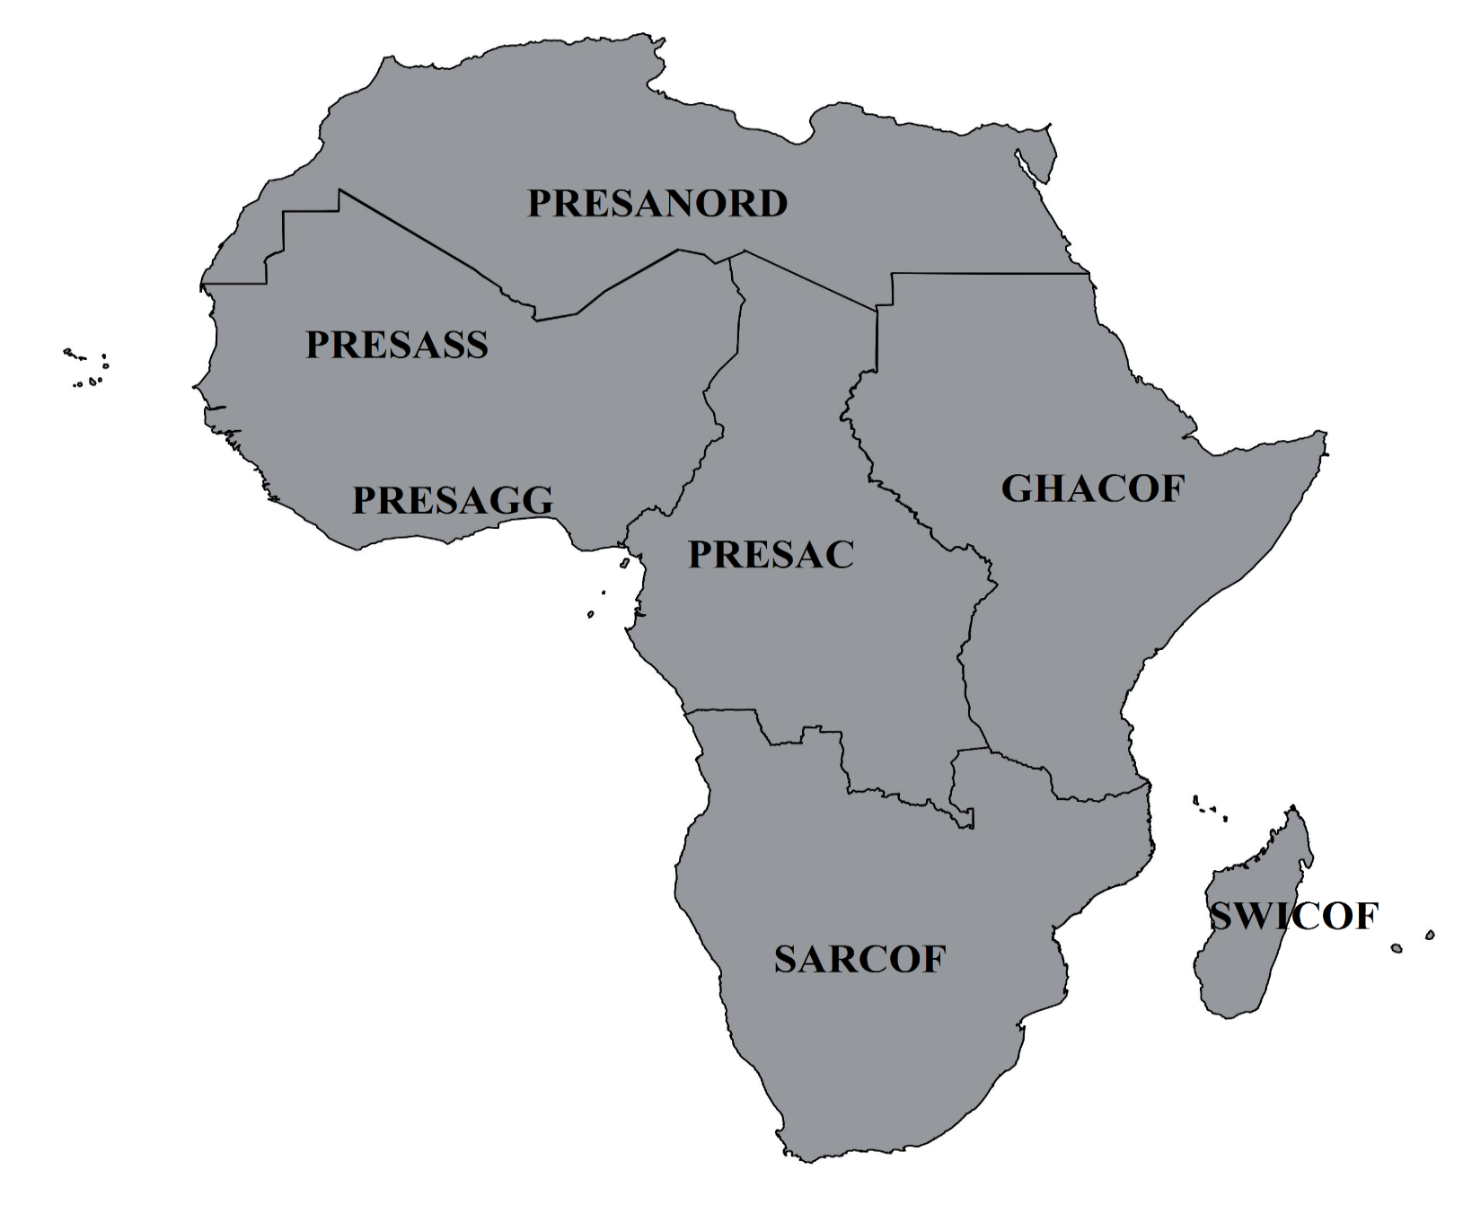
ACMAD SPEARHEAD
Regional Climate Outlook Forums in AFRICA
CORE ACTIVITY OF RCCs

Slide 5
