Slide 1
Deliverables D1.1-1.2-1.3-1.4
Financial reporting
Cloud platform
EbA & GSTIC proposals

Slide 2
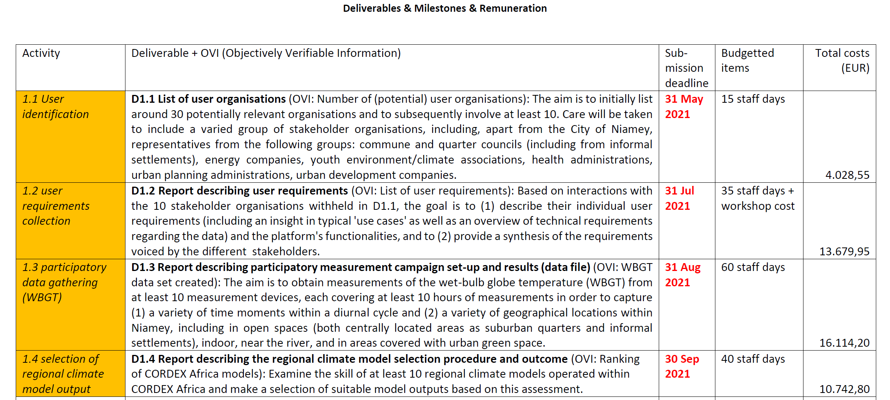

Slide 3
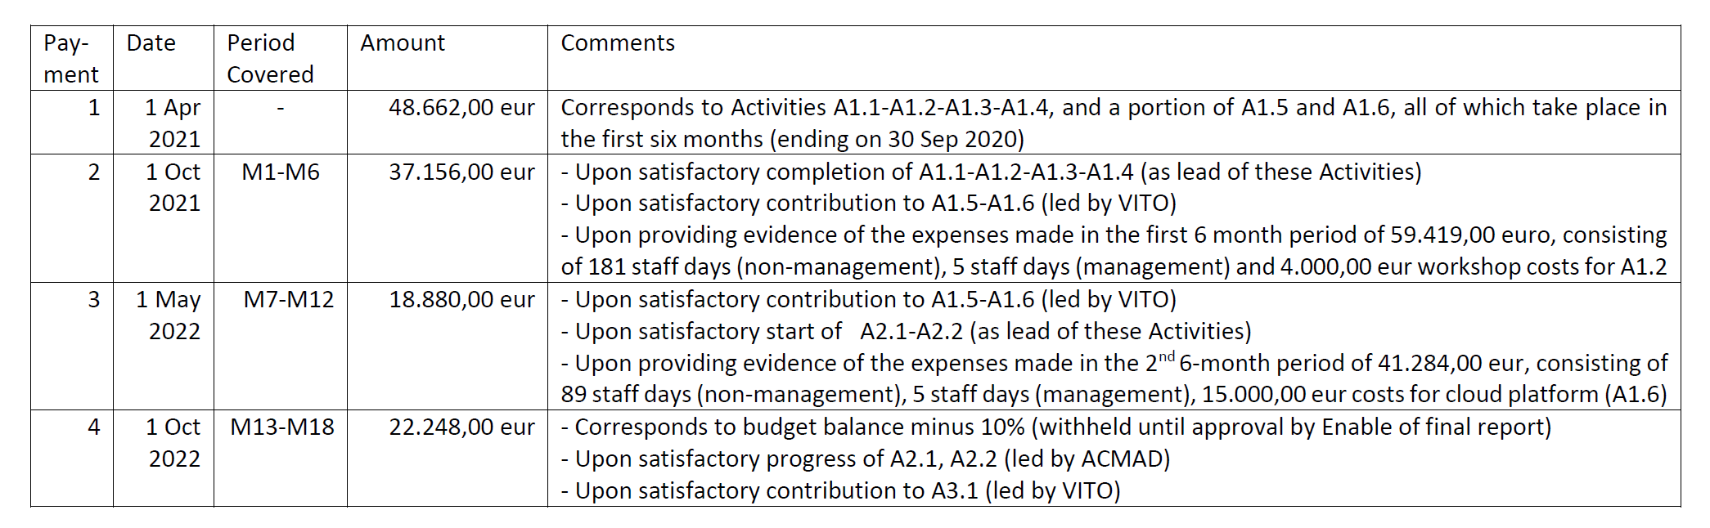
- Raf will be in touch regarding the financial reporting
- We have to organise a meeting on the cloud platform soon

Slide 4
‘Global EbA Fund’ proposal
“3 million trees for Niamey” (3MT)
Goal: provide scientific evidence of benefits of urban trees (multi-sectoral) – among other to underpin substantiated applications to international climate funds
Partners: VITO, ACMAD, Niamey-based NGO (Ville de Niamey & perhaps CNEDD as non-financed partner)
Total budget max 250,000 USD
Possible role ACMAD:
  Measurements (WBGT, soil moisture, thermal IR camera, …)
  Workshops
  International dissemination

Slide 5
GSTIC (Flemish Climate Finance) proposal
“Benefits of Urban Green Infrastructure” (BUGI)
Goal: provide scientific evidence of benefits of urban trees (multi-sectoral) – among other to underpin substantiated applications to international climate funds
Partners: VITO, Ville de Niamey, ACMAD, CO2 mechanisms expert
Total subsidy 200,000 eur (85% reimbursement rate), staff costs are limited (instead workshops, dissemination material, travel, …)
Possible role ACMAD:
  Measurements (WBGT, soil moisture, thermal IR camera, …)
  Workshops
  International dissemination

